Slide 1
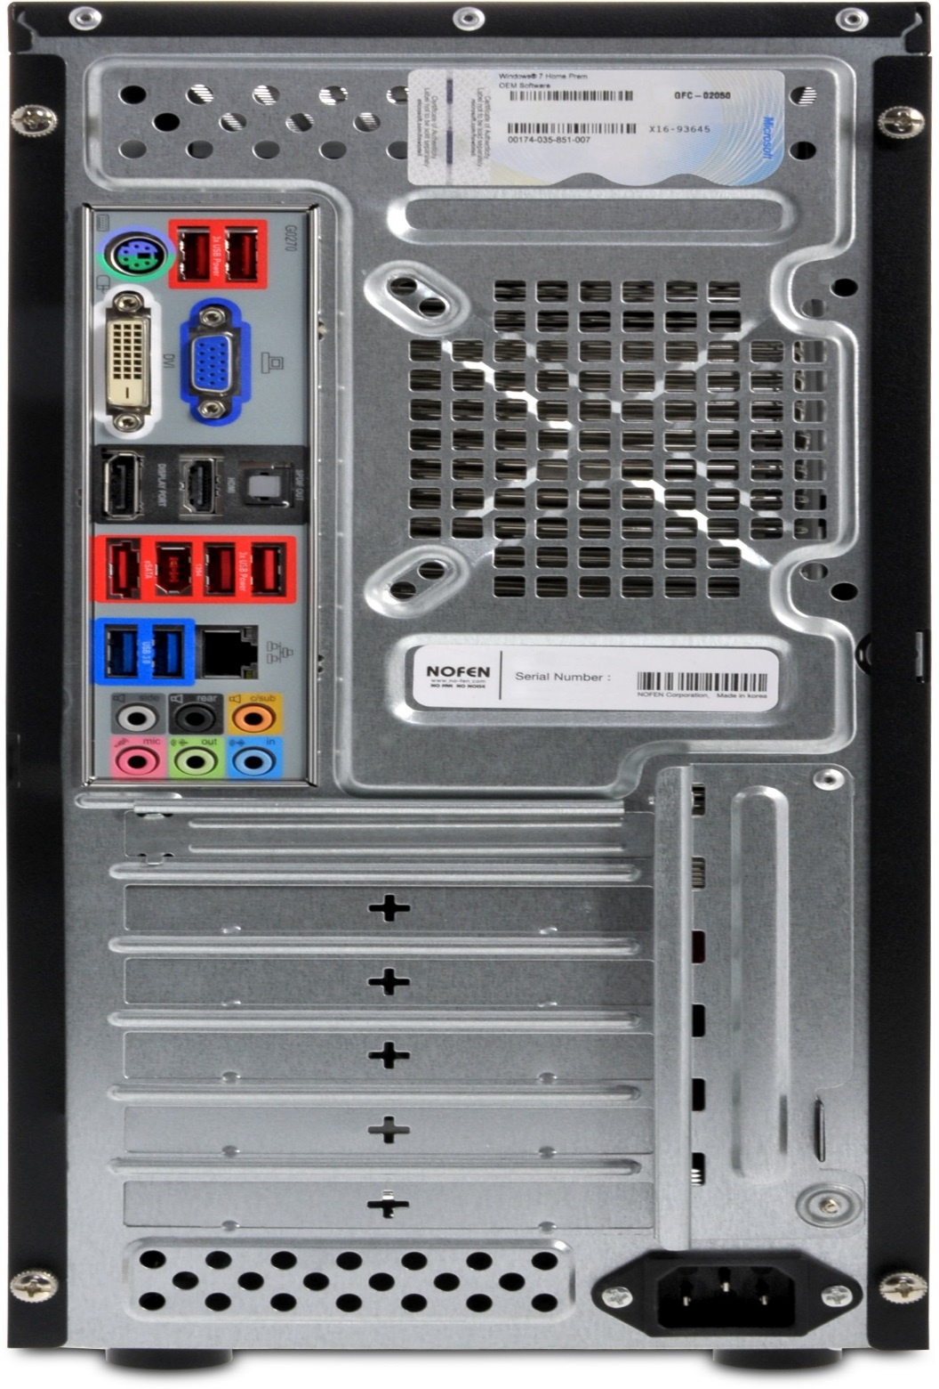


Mouse and Keyboard Interfaces
Monitor Interface
USB Ports
Audio Inputs / Outputs
Ethernet Interface
Power cord and power switch

